Slide 1

Real Estate Market
The impact of COVID-19 in Ontario’s Real Estate Market
Authors:
Emilia Lubanska, Jorge Arriola, Marina Ercoli, Monica Lin, Ulisses Pinto

Slide 2
Motivation & Summary
Goal & Hypothesis
To analyse the impact of Covid-19 on the real estate market comparing 2019 and 2020 data from Ontario.
We believe that indicators related to the real estate market will have a lower performance in 2020 than in 2019. (e.g. less houses sold in 2020 than in 2019)
Questions
What are the number of Covid-19 cases reported in Ontario?
What is the impact of Covid-19 on the real estate market?
Does it impact the interest rates?
Is there any correlation between Covid-19 and the number of houses sold?
What about price fluctuation?

Slide 3

Data Sources
Canada Mortgage and Housing Corporation, housing under construction in all centres 10,000 and over for Canada, provinces, and selected census metropolitan areas (Type: CSV) https://open.canada.ca/data/en/dataset/1995a476-68fd-4fe2-973f-2dd47f7f6c2c
Confirmed positive cases of COVID19 in Ontario (Type: CSV)
https://data.ontario.ca/dataset/confirmed-positive-cases-of-covid-19-in-ontario/resource/455fd63b-603d-4608-8216-7d8647f43350
Average, Median and Price Percentiles for Unabsorbed Homeowner and Condominium Units (Provinces) – Ontario (Type: API)
https://www.quandl.com/api/v3/datasets/CMHC/HPPA50_ON.json?api_key=9aGzLsxCKNH7a9NEiKi5
Canadian Interest Rates and Monetary Policy Variables: 10-Year Lookup (Type: CSV)
https://www.bankofcanada.ca/rates/interest-rates/canadian-interest-rates/

Slide 4
Data Cleanup & Exploration
Cleanup process
Based on the main data frame, create a new chart that only includes the information we need
Retrieve Data
Create data frames
Note: We all agreed to create a column named ‘Date’ with the same format for all datasets. Allowing us to grouping the datasets easily.

Slide 5
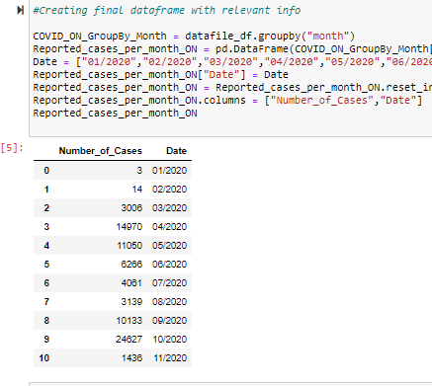
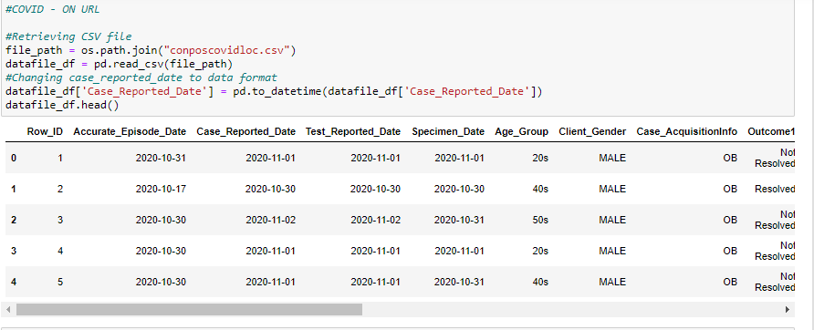
Data Cleanup
Before
Now

Slide 6
Exploration
Insights while exploring the data that you didn't anticipate:
Insights > From a visual inspection, we noticed that the number of buildings being constructed in Ontario in 2019 and 2020 were very similar. Hence, Covid-19 did not seem to have a direct impact on this
Problems that arose after exploring data | How we solve them:
Problems >

Slide 7
Exploration
Interesting figures developed during exploration:
Final Jupyter Notebook
Figures Summary

Slide 8
Findings
We can observe weak correlation between increasing number of cases and number of houses sold as well as average prices
The correlation between estimated mortgage rate is strong which is a result of banking response for the current situation
Number of sold houses in 2020 is on the similar level as in 2019 which indicates that Ontario real estate market is not affected by Covid 19

Slide 9
Data Analysis
Steps to analyze the data and answer proposal questions:
………
……….
Interesting figures developed during analysis :
Final Jupyter Notebook

Slide 10
Discussion
Findings:
………
……….
Inferences | General conclusions:
………
……….

Slide 11

Post Mortem
Difficulties that arose, and how we dealt with them:
………
……….
Additional questions | What would we research next?
………
……….

Slide 12

Q&A with the audience

Slide 13
Thank You!
Our photo to be added
Covid-19
Emilia Lubanska, Jorge Arriola, Marina Ercoli, Monica Lin, Ulisses Pinto

